Slide 1
Introduction to R.3 Workshop in Methods and Indiana Statistical Consulting Center
Thomas A. Jackson
September 23, 2011

Slide 2
plot() function
plot() is the primary plotting function
Calling plot will open a new plotting window
Documentation: ?plot
For complete list of graphical parameters to manipulate: ?par

Slide 3
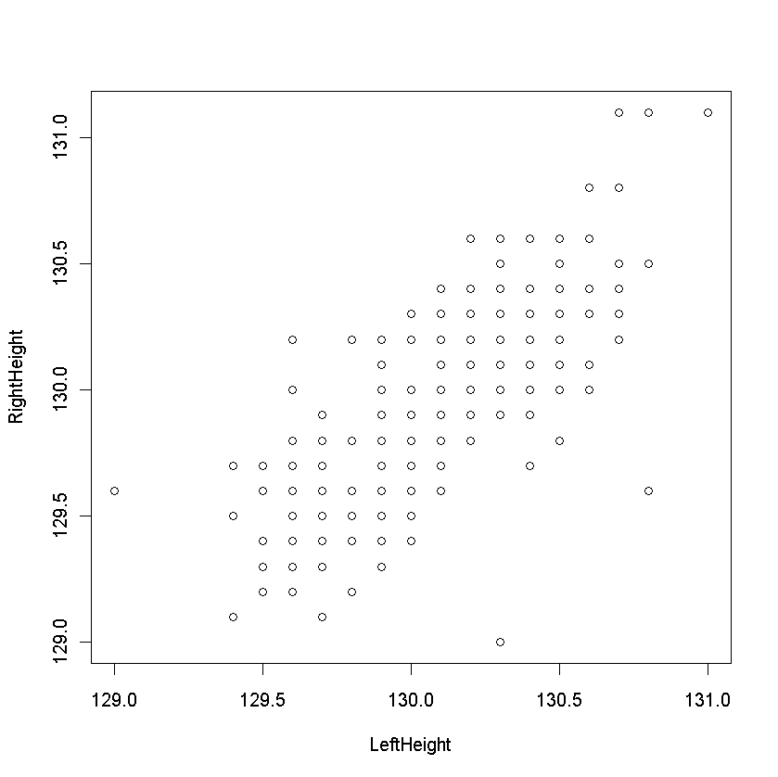
plot() function
Let’s visualize the SwissNotes.csv data.
After loading the data into R, attach the data frame using attach(data).
Let’s try a scatter plot of LeftHeight by RightHeight.
>plot(LeftHeight, RightHeight)

Slide 4
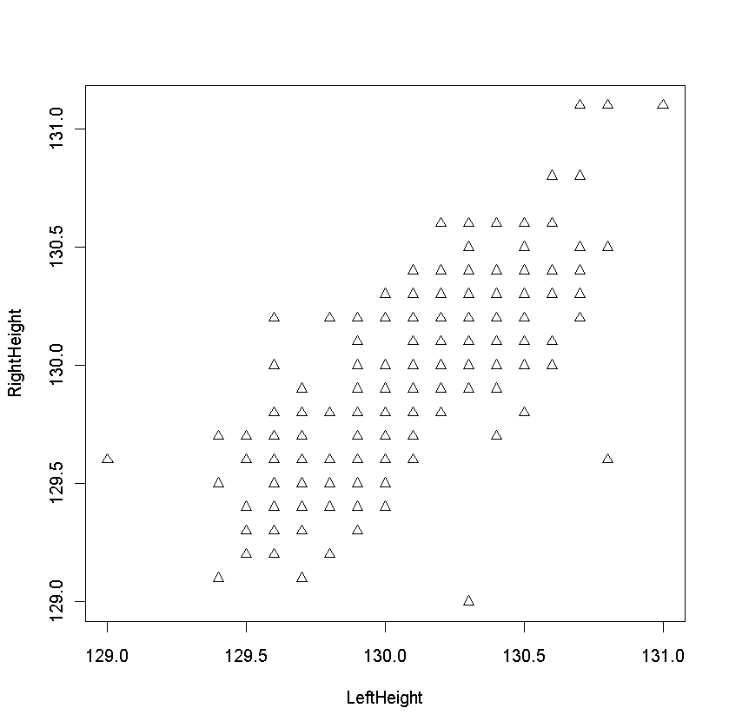
plot() function
Change symbols: Option pch=.
See ?par for details.
>plot(LeftHeight,RightHeight,pch=2)

Slide 5
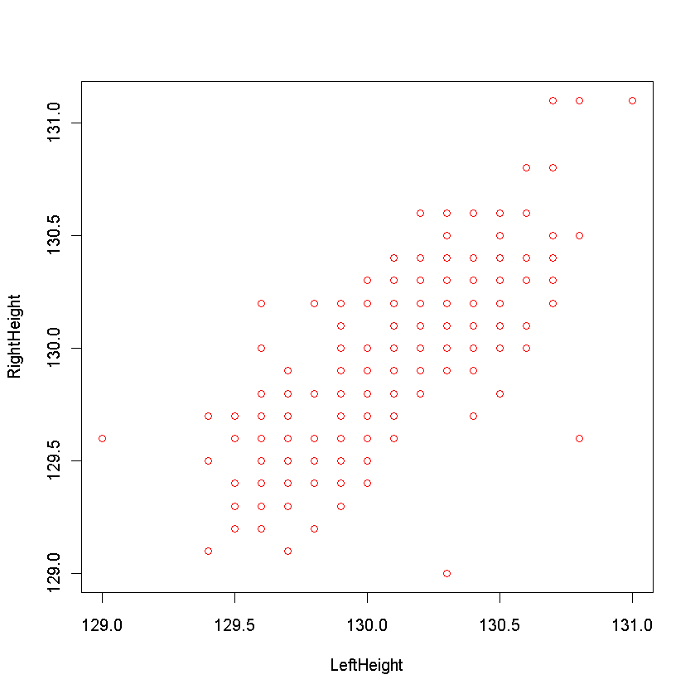
plot() Function
Change symbol color: Option col=
Specify by number or by name: col=2 or col=“red”
Hint: Type palette() to see colors associated with number
Type colors() to see all possible colors
> plot(LeftHeight, RightHeight, col=“red”)

Slide 6
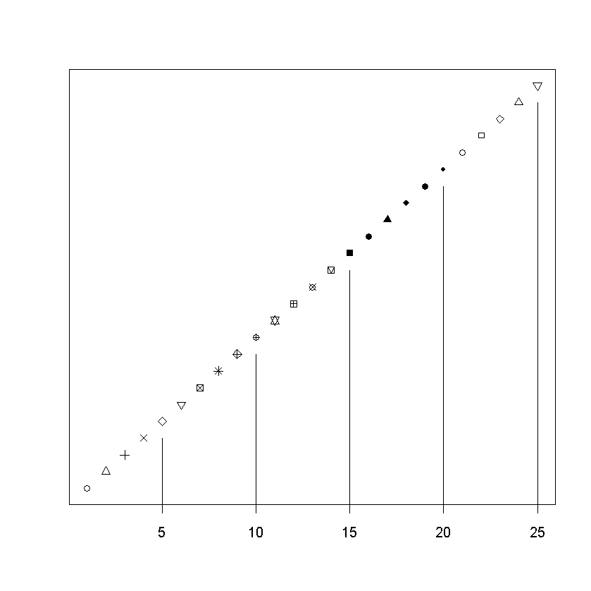
What types of points can we get?

Slide 7
plot() Function
Change plot type: Option type =
“p” for points
“l” for lines
“b” for both
“c” for lines part alone of “b”
“o” for both overplotted
“h” for histogram like (or high-density) vertical lines
“s” for stair steps
“S” for other steps, see Details below
“n” for no plotting

Slide 8
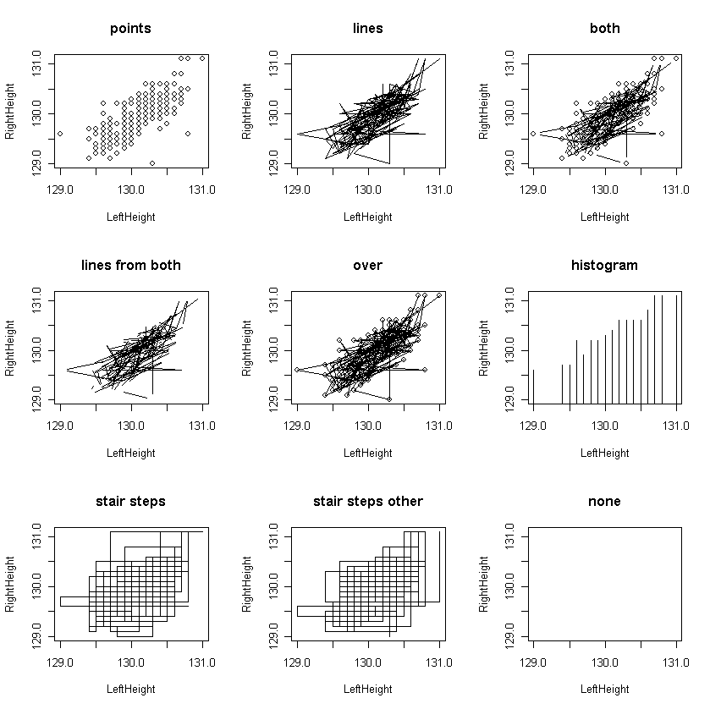

Slide 9
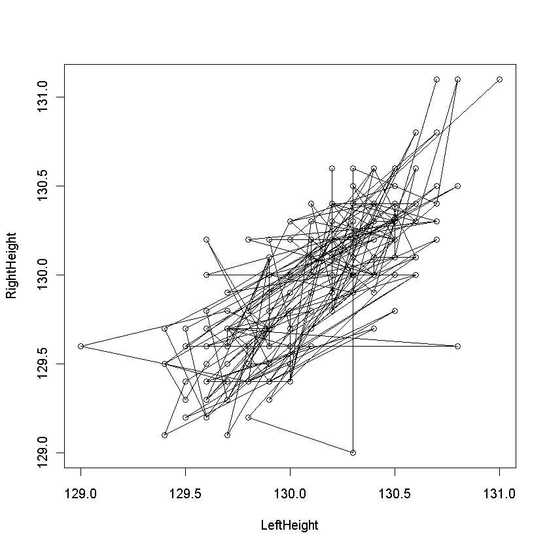
Plot() Function
Points with lines…works better on sorted list of points
>plot(LeftHeight,RightHeight,type=“o”)

Slide 10
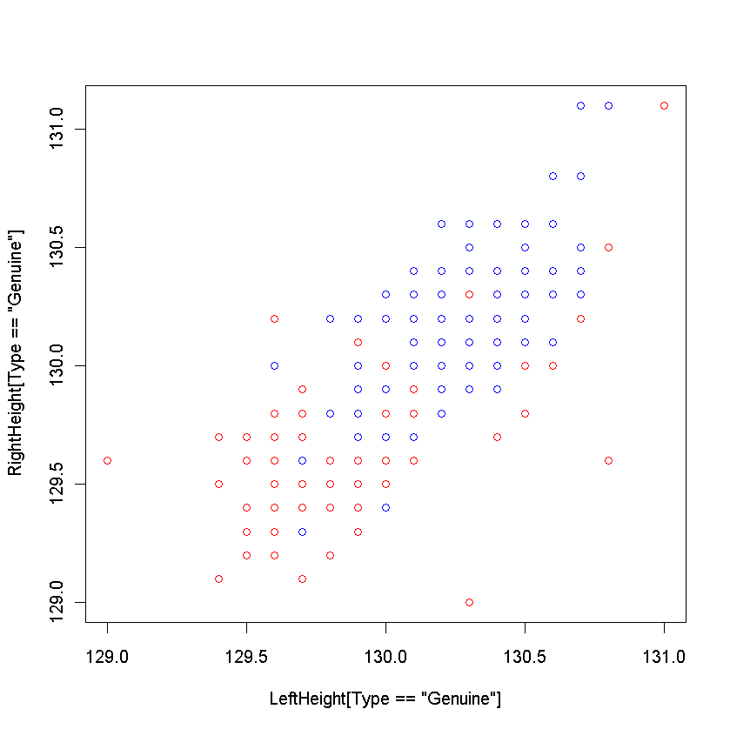
Scatterplots for Multiple Groups
Use plot() with points() to plot different groups in same plot
Genuine notes vs. Counterfeit notes
>plot(LeftHeight[Type==“Genuine”],Rightheight[Type==“Genuine”],
col=“red”)
>points(LeftHeight[Type==“Counterfeit”],RightHeight[Type==“Counterfeit”] ,col=“blue”)

Slide 11
Axis Labels and Plot Titles
The plot() command call has options to
Specify x-axis label: xlab = “X Label”
Specify y-axis label: ylab = “Y Label”
Specify plot title: main = “Main Title”
Specify subtitle: sub = “Subtitle”

Slide 12
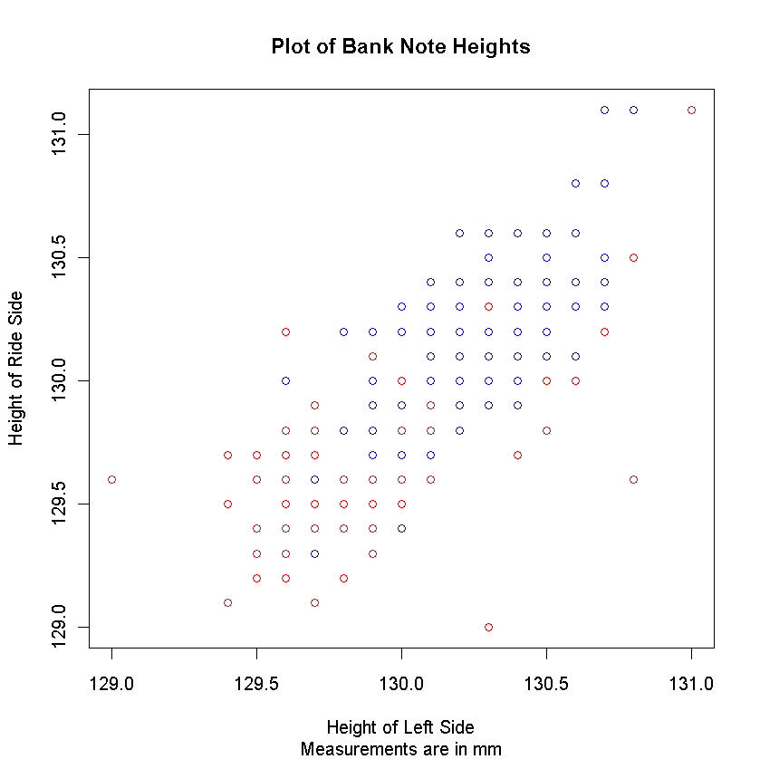
Axis Labels and Plot Titles
>plot(LeftHeight[Type==”Genuine”],RightHeight[Type==“Genuine”],
col=“red”,main=“Plot of Bank Note Heights”,sub=“Measurements are in mm”,xlab=“Height of Left Side”,ylab=“Height of Right Side”)
>points(LeftHeight[Type==“Counterfeit”],
RightHeight[Type=“Counterfeit”],col=“blue”)

Slide 13
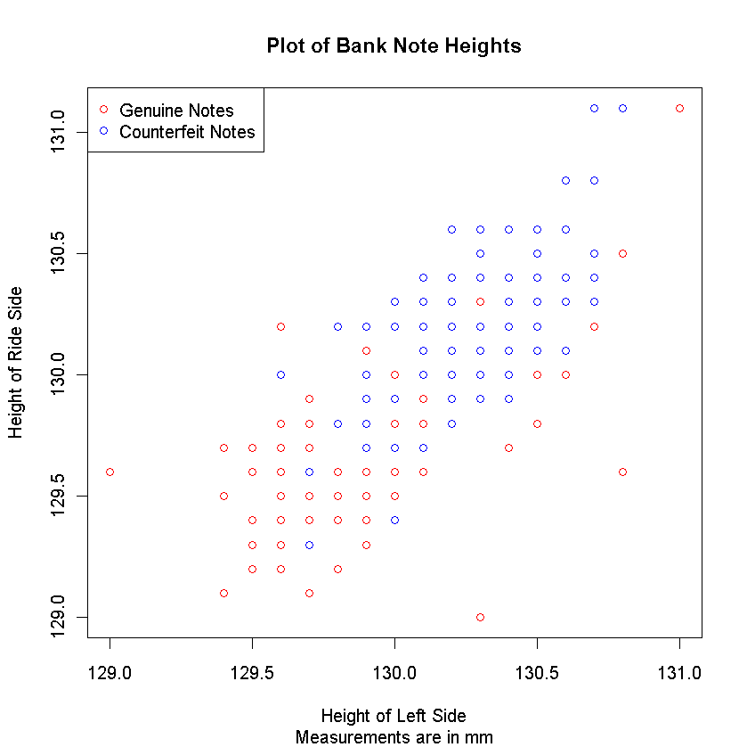
Legends
legend(“topleft”,c(“Genuine Notes”,
”Counterfeit Notes”),pch=c(21,21),col=c(“red”,”blue”))

Slide 14
Try It!
Using the cardiac data set, try the following exercises
Create a scatterplot of age vs. peak heart rate (pkhr). Be sure to label your axes and title the plot.
Using information available on the points() documentation page, adjust your scatterplot to have symbols that are filled blue diamonds with green border.
In your age versus peak heart rate scatterplot, plot the males and females with different symbols and different colors. Add a legend to your plot.

Slide 15
Adding Lines
To add straight lines to plot: abline()
abline() refers to standard equation for a line:
y = bx + a
Horizontal line: abline(h= )
Vertical Line: abline(v= )
Otherwise: abline(a= , b= ) or abline(coef=c(a,b))

Slide 16
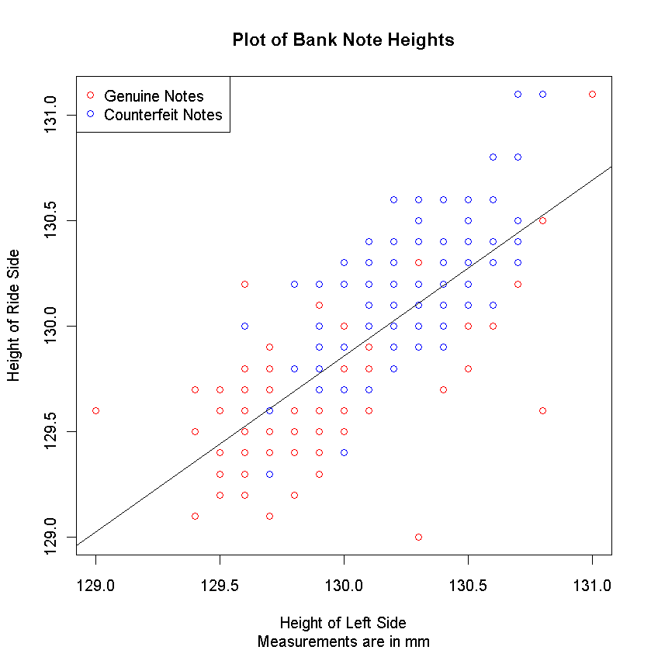
Adding Lines
> abline(coef=c(21.7104,0.8319))

Slide 17
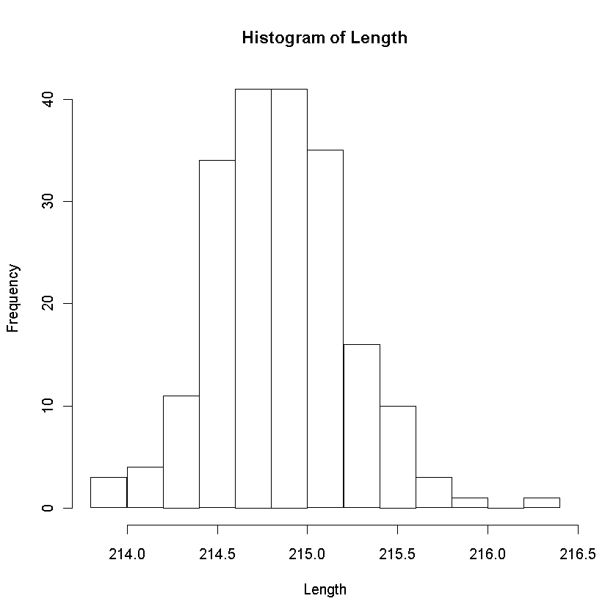
Histograms
Histograms are another popular plotting option.
> hist(Length)

Slide 18
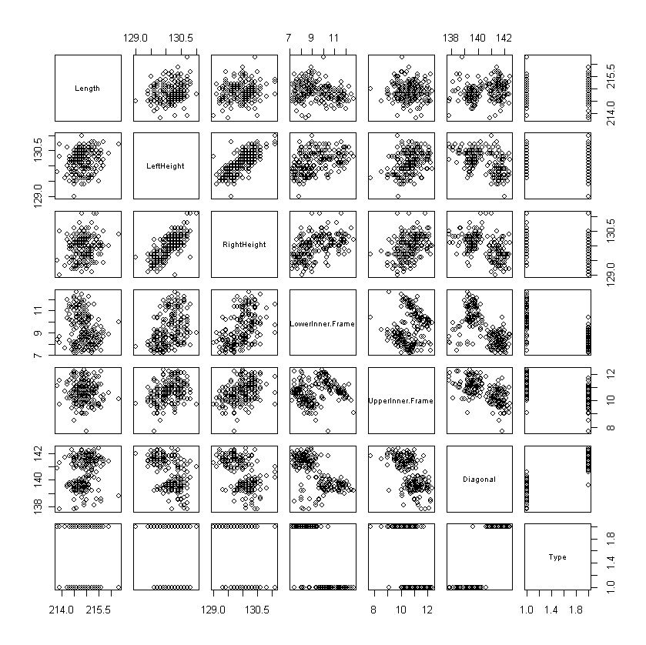
pairs() Function
Using the SwissNote Data
> pairs(swiss)

Slide 19
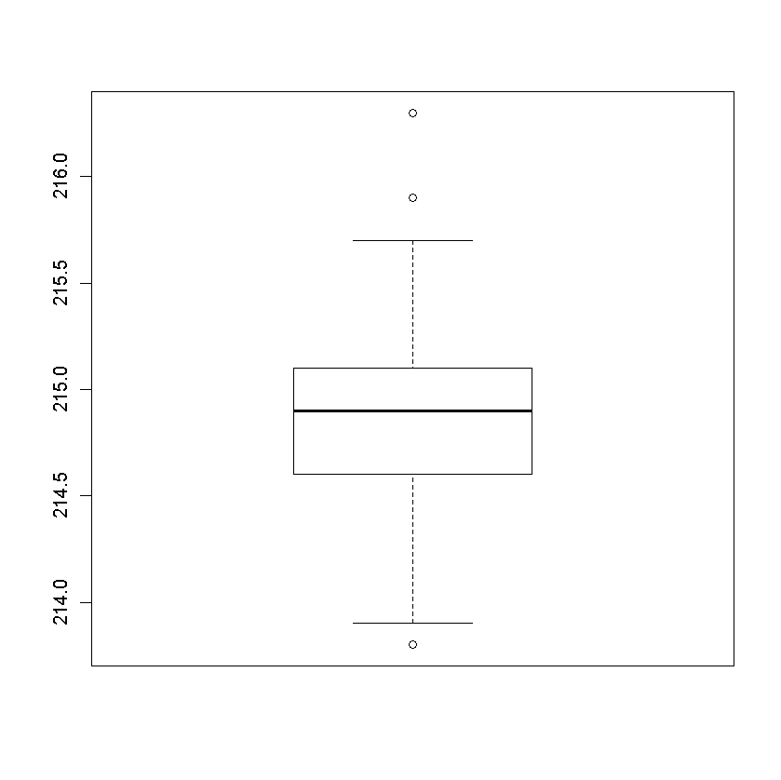
Boxplots
To create boxplots: boxplot()
Specify one or more variables to plot.
> boxplot(swiss$Length)
> boxplot(swiss[,2:3])

Slide 20
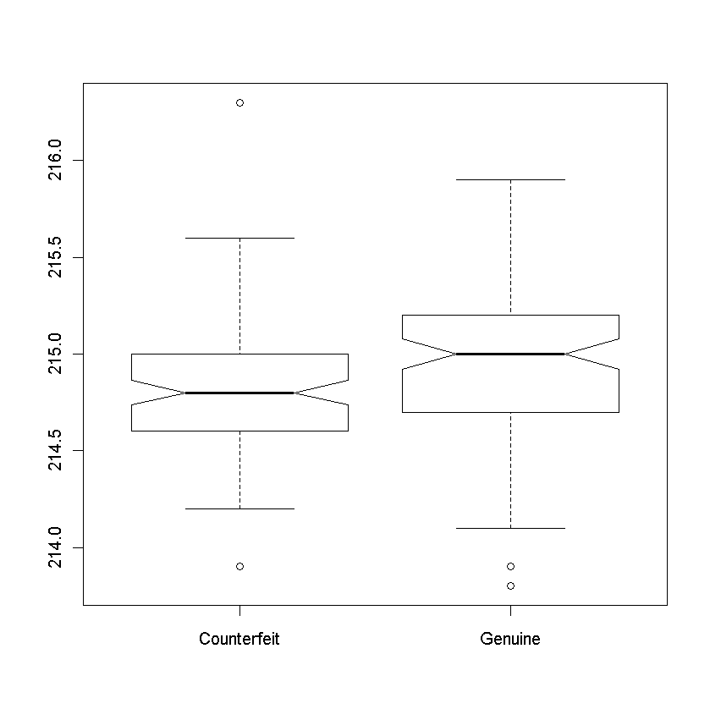
Boxplots
Use a formula specification for side-by-side boxplots.
Note: boxplot() has many options, e.g. notches. See ?boxplot.
> boxplot(Length~Type,notch=TRUE,data=swiss)

Slide 21
Try It!
Using the cardiac data set, try the following exercises
Create histograms for basal blood pressure (basebp) and systolic blood pressure (sbp).
Try creating boxplots of the same variables. Can you do separate plots for Males and Females?

